Slide 1
Playtesting: Hikari no To
Computer Games Laboratory 2017/2018
Team Pick One:
Muhammad Inshal Uddin
Paul Preißner
Jonas Mayer
Artem Bishev
Technical University of Munich
24.01.2018

Slide 2
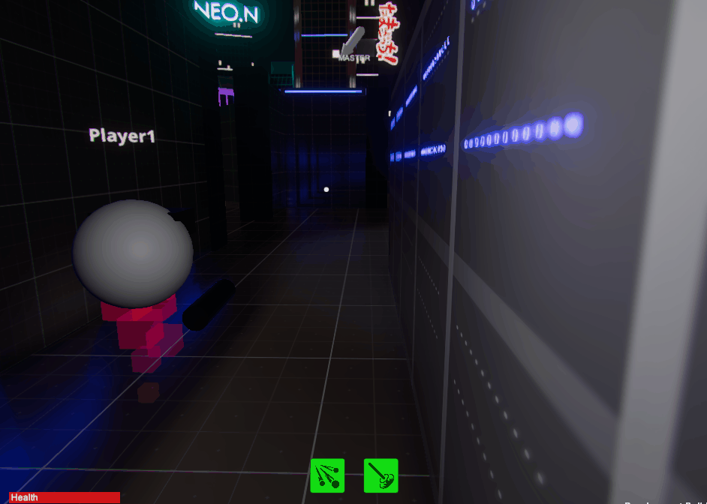
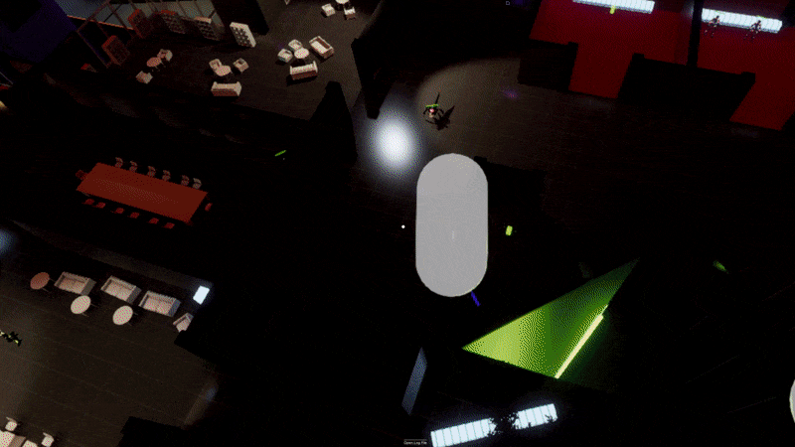
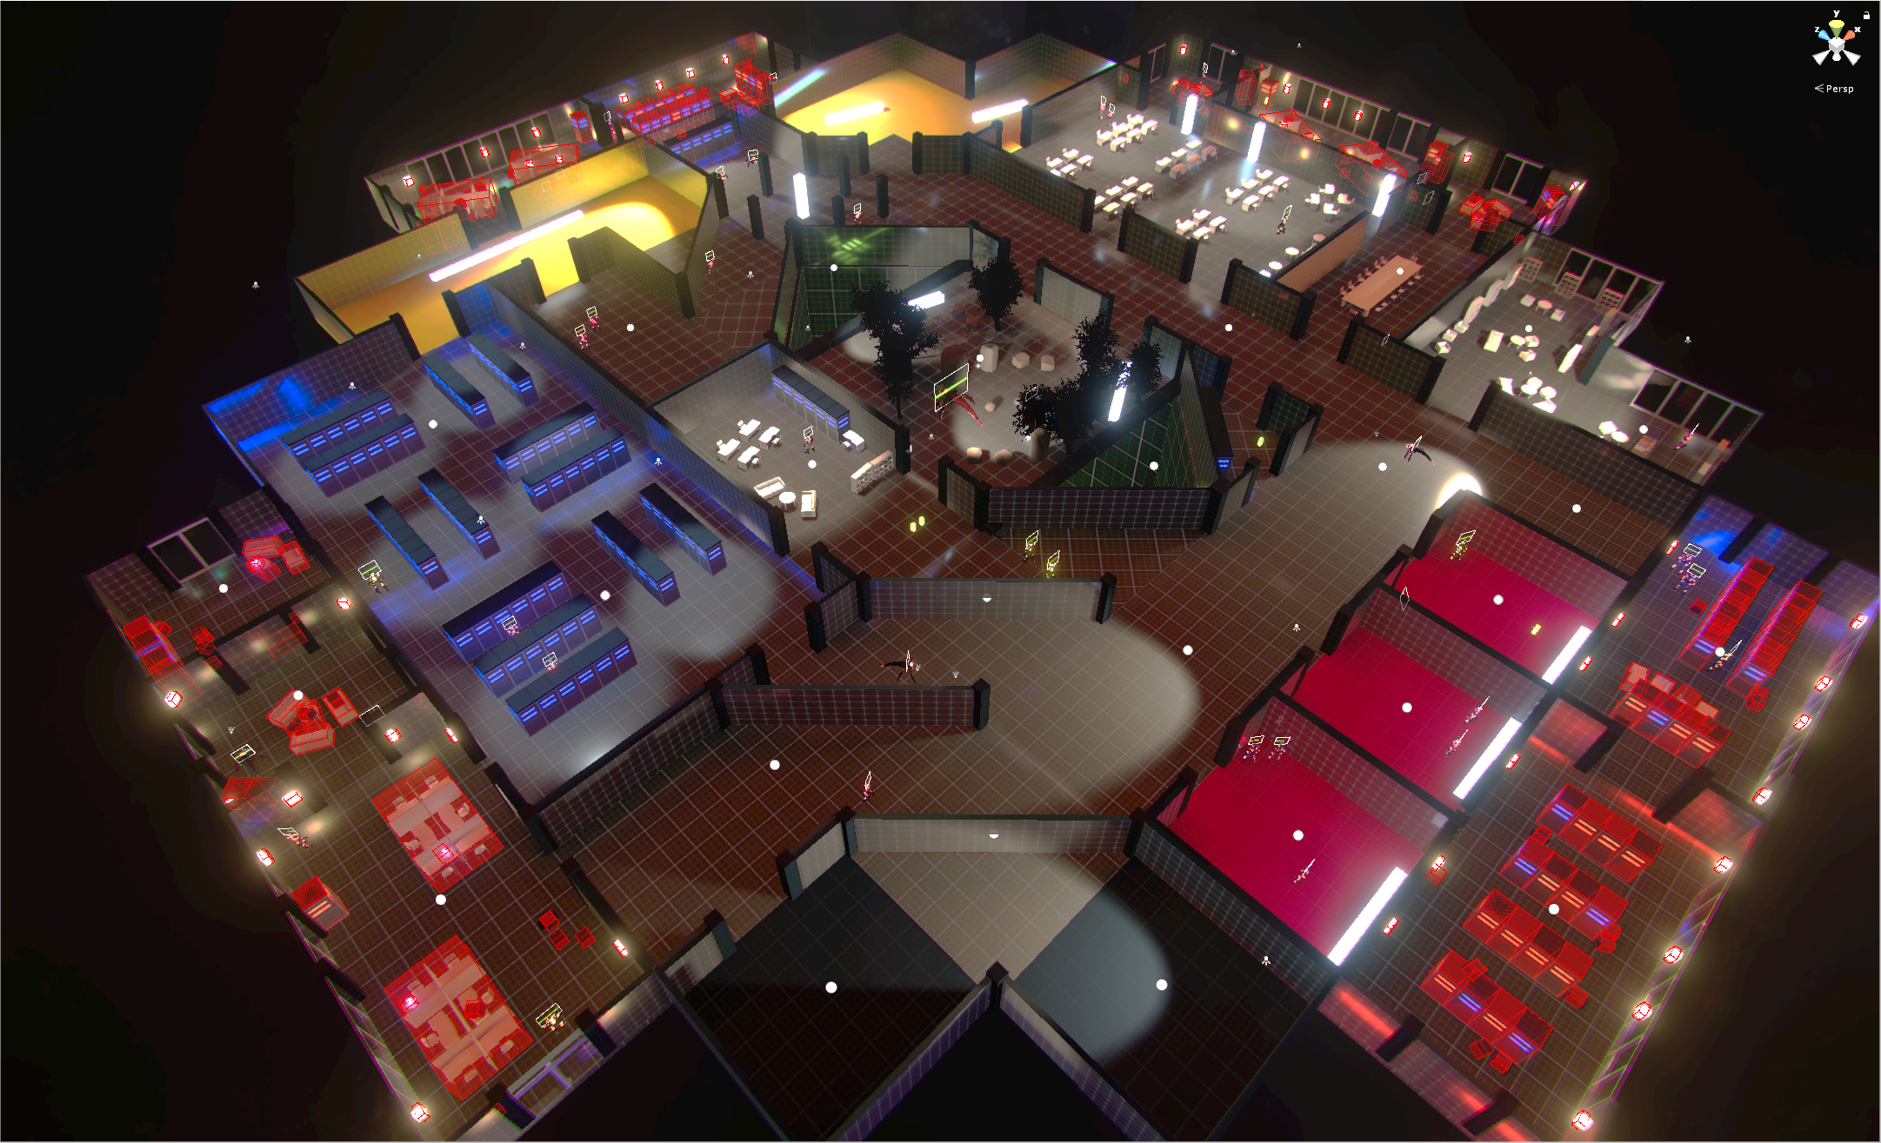
Before playtesting
New feature: collectibles
Prepare the level:
increase size
rearrange enemies, spawn points
teleporting for master

Slide 3
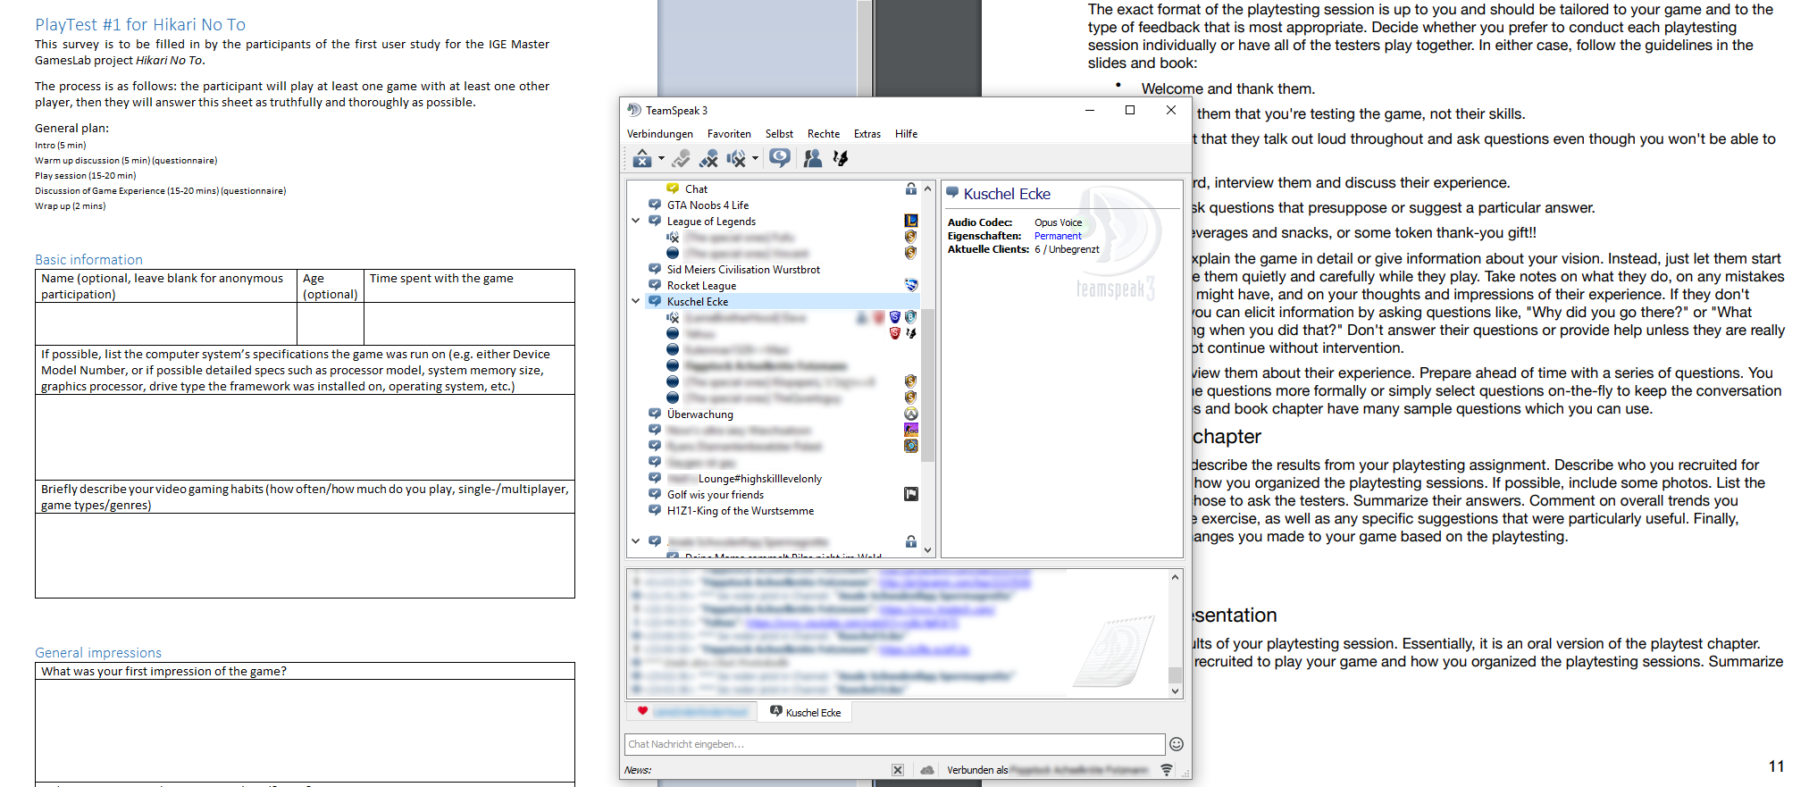
Playtest, larger scale
Tricky, need multiple players for proper test

Slide 4
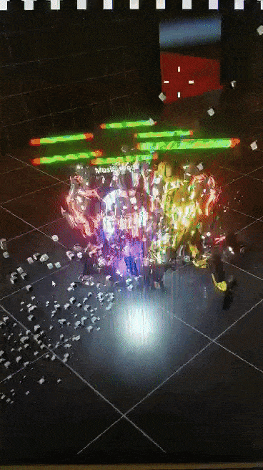
Playtest, larger scale
Crawler testers only, 7 people in total
Distribute build in Teamspeak server filled with colleagues and watch the madness unfold
(Nearly) full matches, no prior instructions
Plenty of unfiltered feedback
BAD

Slide 5
Playtest, larger scale
Feedback included (solved, partially solved, unsolved):
Technical issues (events not triggering, disconnects, update rate/smoothing)
Interface issues (UI scaling, lack of indicators)
Gameplay issues (class imbalance, master awareness, unsatisfying enemy search, boring after death)
Miscellaneous issues (main menu glitchy, bad sound mix, janky camera)
and more…

Slide 6
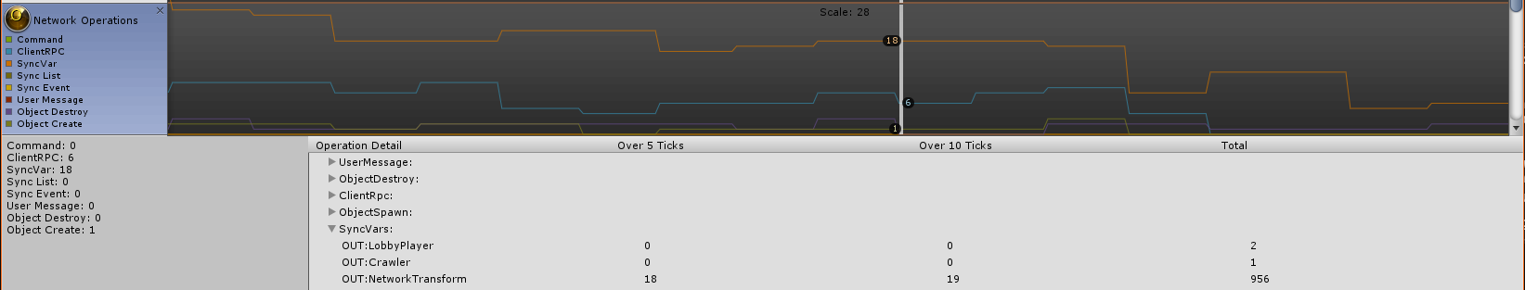
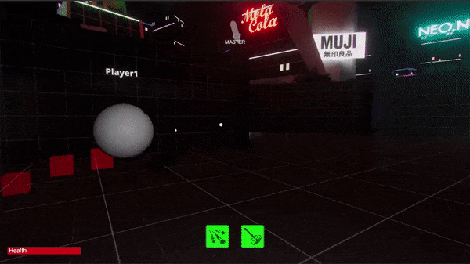
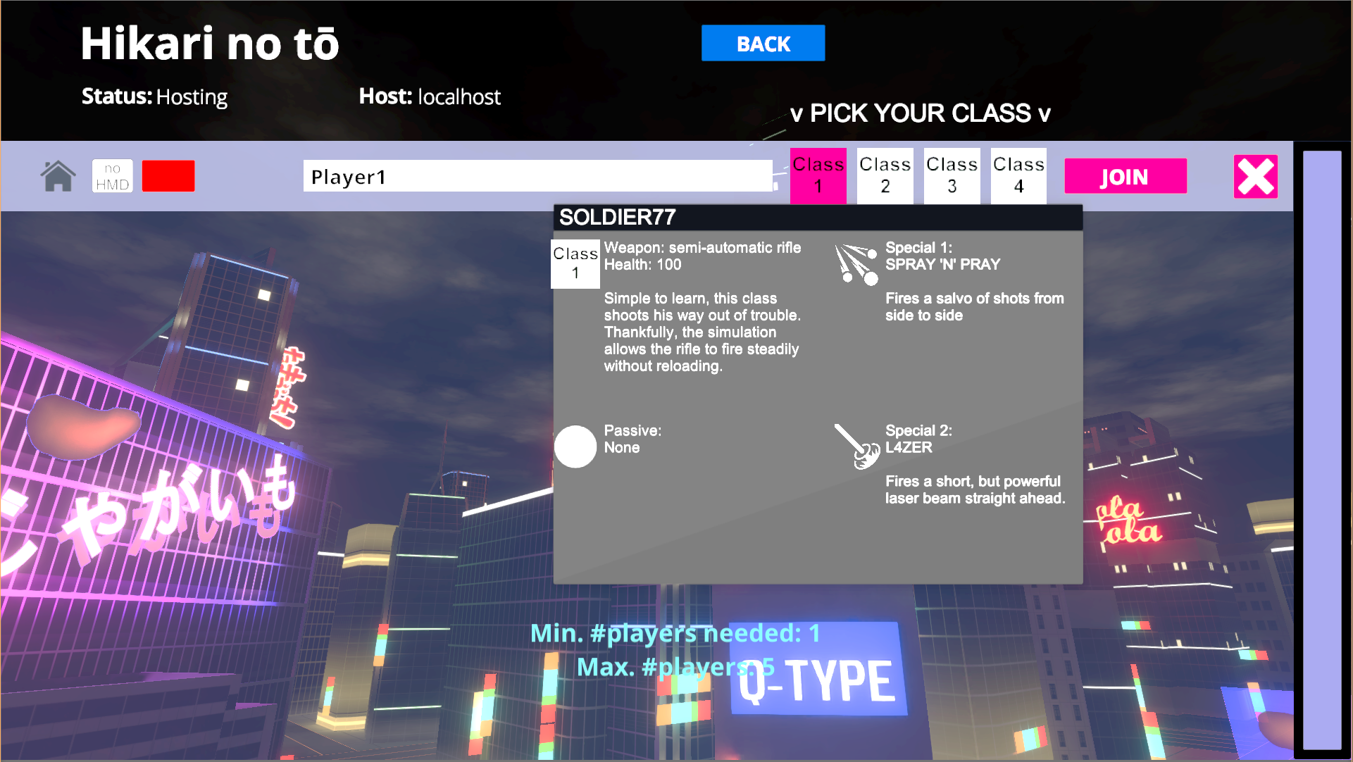
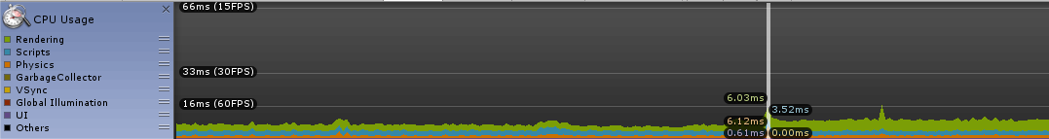
Visuals, UI, audio, profiling
Changes to:
Main menu, UI again
FX againSound effects (~50%)
Performance improved by 50% + network profiling
Next steps: more UI indicators, lighting optimization, sfx

Slide 7
Game Balancing
Enemies made more deadly
Soldier
The “Long Distance Fighter”
Decreased overall damage
Infiltrator
The “Stealth Character”
Invisibility improved
Backstab damage reduced
Sumo
The “Tank”
Increased damage
Health increased
Berserker
The “Close Quarters Fighter”
Rage requirement reduced
Rage improved

Slide 8
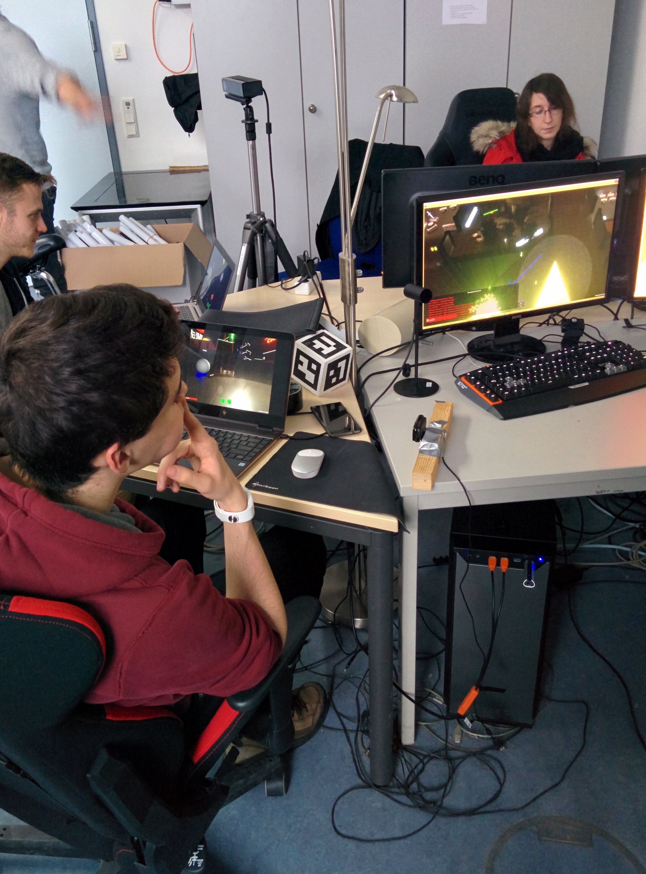
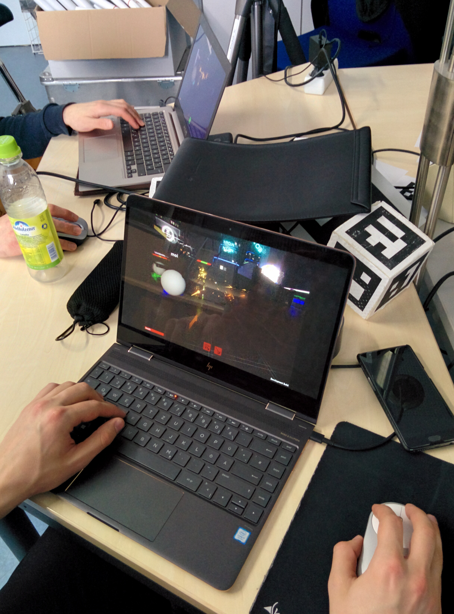
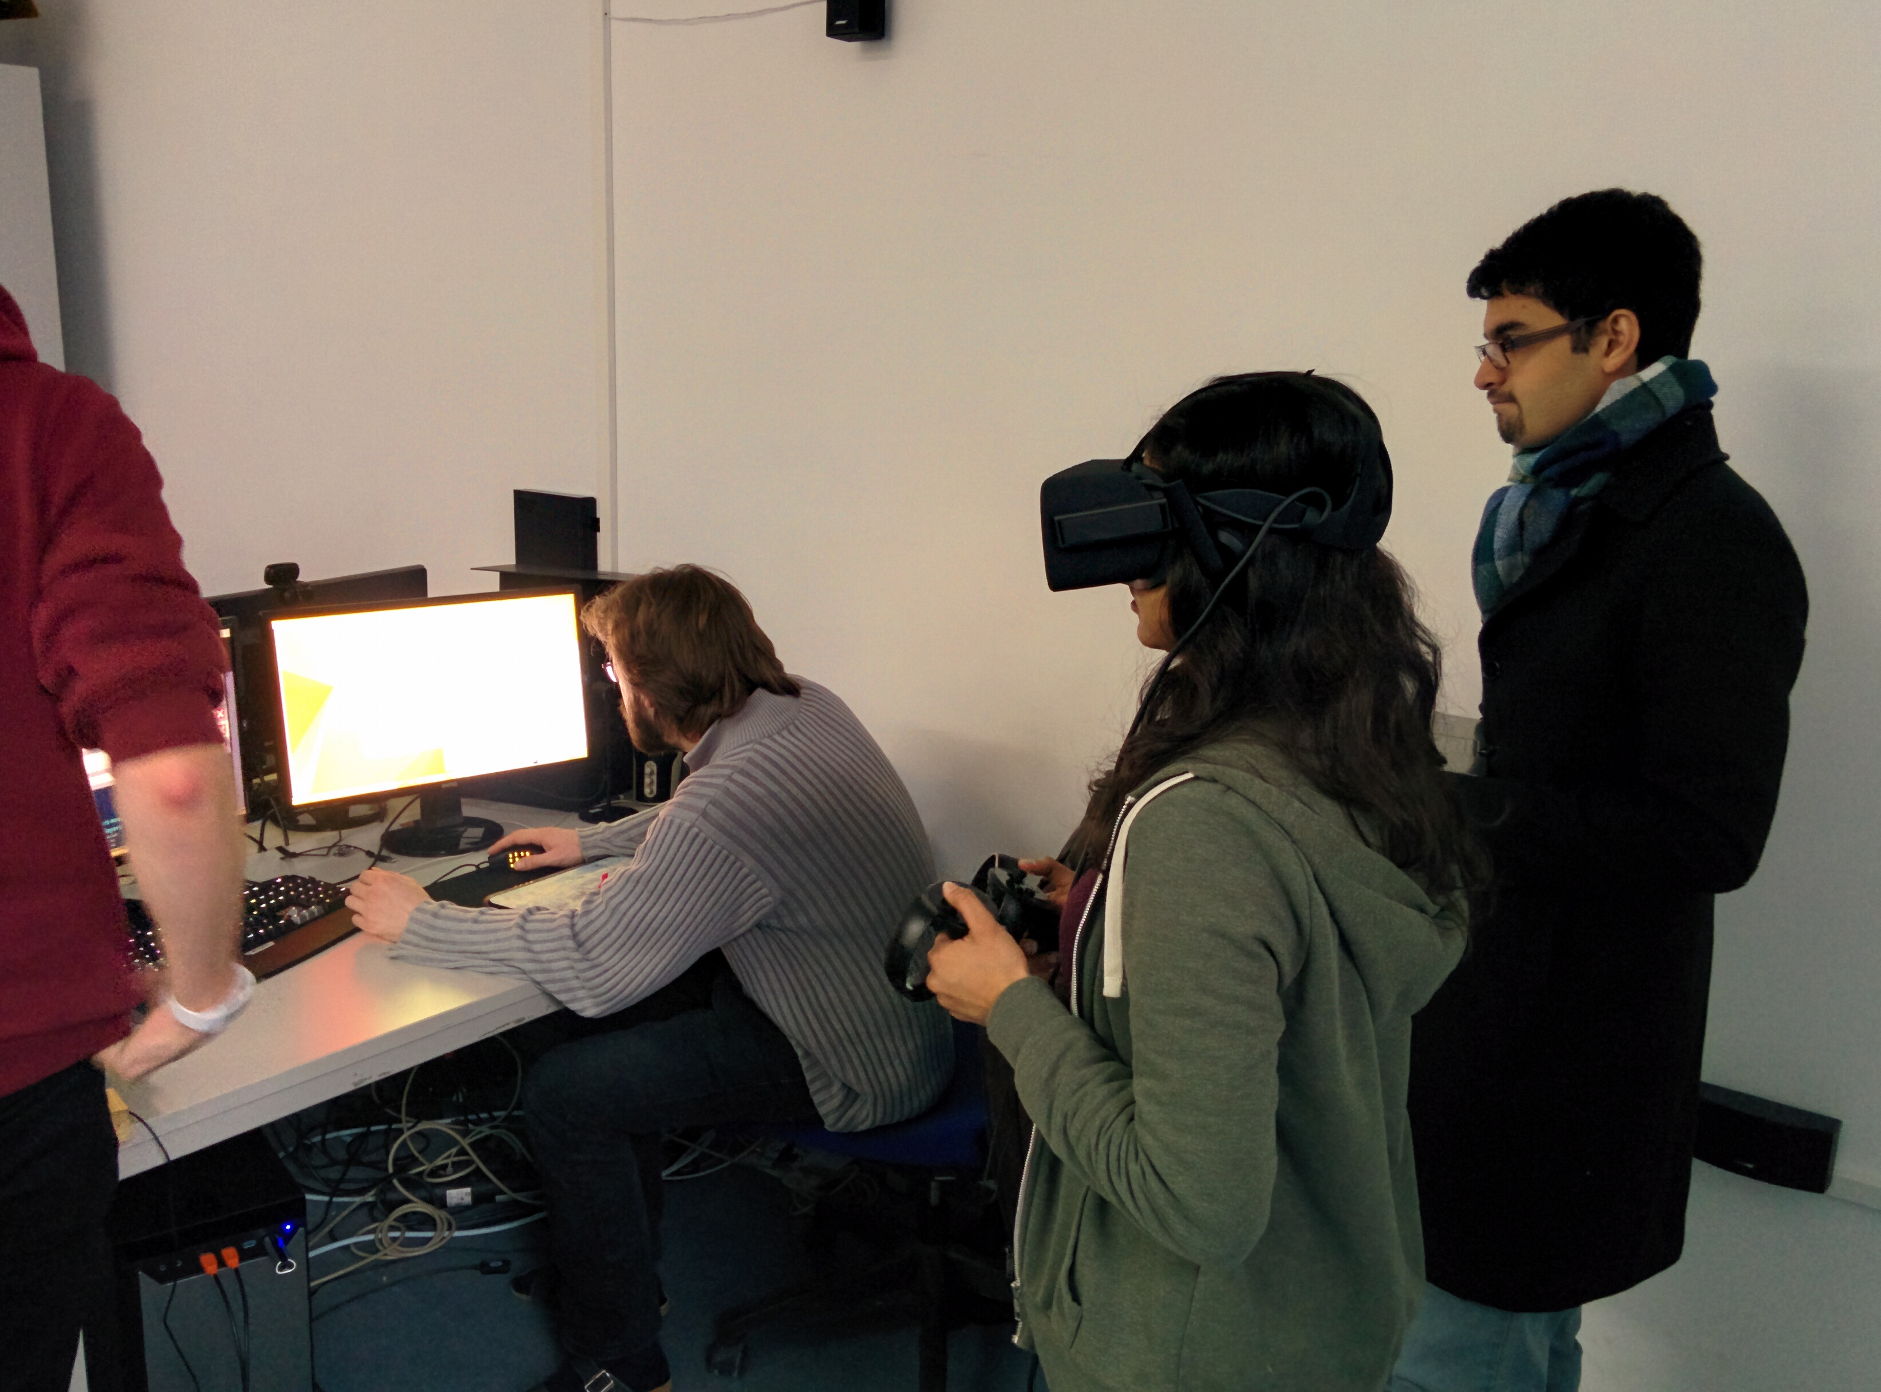
Master Playtest: The Playtesters
Two friends from the Informatics department
One had experience with games, the other did not
Neither had played any games in VR before

Slide 9
Master Playtest: The Feedback
The good:
Throwing fireballs was fun!
Saving allies gave them a sense of purpose
Killing enemies by pointing
Feeling of being a demi-god was delivered
The bad:
Master’s remaining ability pool (mana) was not clear
Controls were a bit difficult and time consuming to use
Multiple play sessions were required to get the master to a decent skill level

